Slide 1

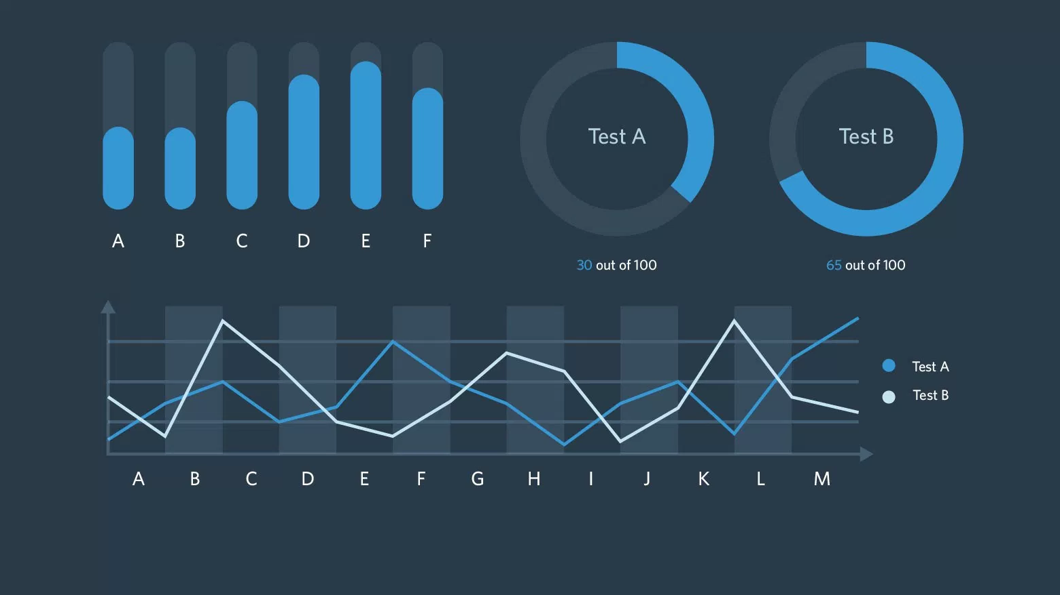
IBM HR Analytics Employee Attrition & Performance
Dashboard

Slide 2
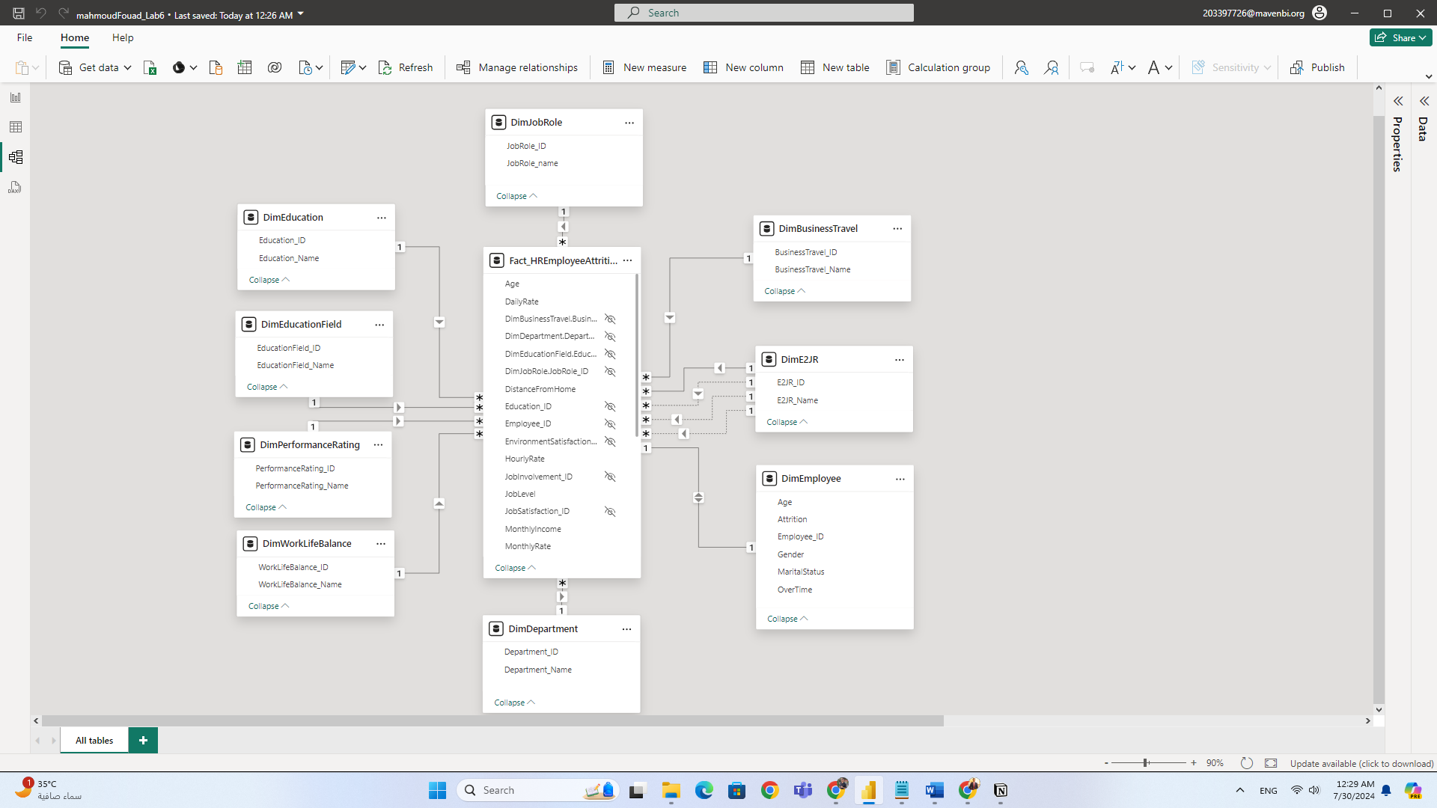
Model View

Slide 3
A comprehensive dashboard designed to provide deep insights into employee attrition and performance using IBM's HR Analytics dataset.
📊 Dashboard Features :
Count of Employees by Various Metrics: Track employee distribution by business travel, department, education level, education field , job level, and more.
Job Involvement and Satisfaction: Analyze employee involvement and satisfaction across different categories.
Work-Life Balance: Visualize the impact of work-life balance on employee engagement and productivity.
Performance Ratings: Correlate performance ratings with various employee demographics.
Marital Status Distribution: See how marital status affects employee demographics.

Slide 4
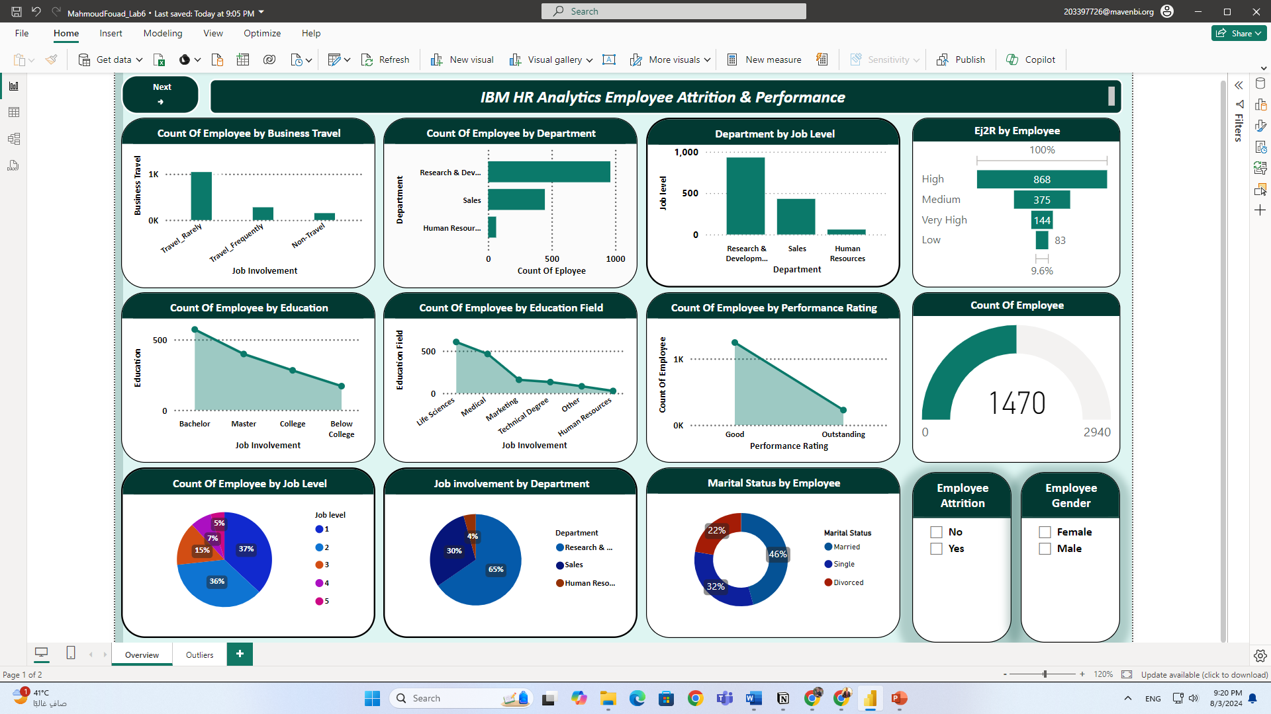
Overview

Slide 5
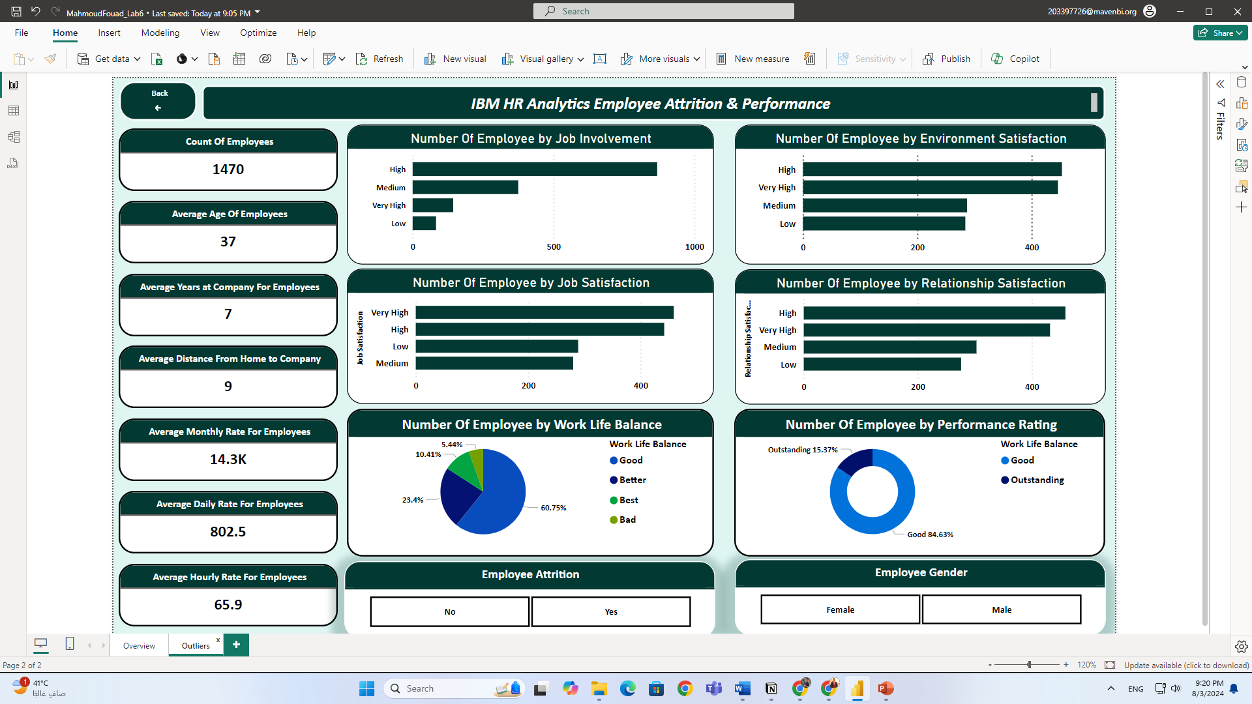
Outliers

